Slide 1
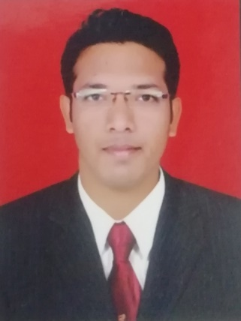
About Presenter
What I am??
CCNA (R & S) Certified.
RedHat (RSCSA)
Hardware ( A+) & Network (N+) Certified.
Mr. Dinesh C. Chaudhari
What I do??
Since 3 years I am working as Network Developer Engineer and System Engineer in Government Confidential Site at Nashik.
Also I am Director of NITS & trainer of Networking N+, CCNA, Cloud, AWS in NITS.
I Have one year working experience with Airtel Bharti as Network Engineer in NOC in Mumbai.
Also I have 2 years working experience as Network and Desktop engineer with HCL learning pvt ltd.

Slide 2

What is Cloud Computing ?

Slide 3
What we are discussing in Cloud Computing now ?
Before Cloud Computing
What is Cloud Computing ?
Types of Cloud Computing
Benefits of Cloud Computing
Who uses Cloud Computing ?

Slide 4



Before Cloud Computing
Company Area
Server Room
Cost
24/7 Electricity
Hardware Maintenance
Technical team maintain
Continue monitoring from software to hardware

Slide 5
What is Cloud Computing ?
Cloud computing is the use of a Network of remote servers hosted on the internet to store, manage and process data rather than a local server or Personal Computer

Slide 6
Pay only what you use
Servers, Databases, Networking, Software, etc.
Storing or accessing your data over the internet
Cloud Computing

Slide 7
Benefits of Cloud Computing ?
Speed
Big amount of resource can be easily available in minutes
Cost
Less expenses on hardware and software
Scalability
Easy to scale or update Cloud capacity
Accessibility
Easy to access data anywhere

Slide 8
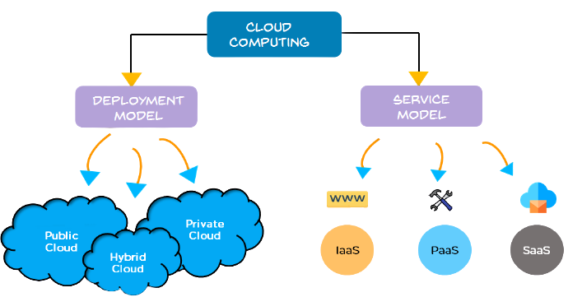
Types of Cloud Computing ?

Slide 9
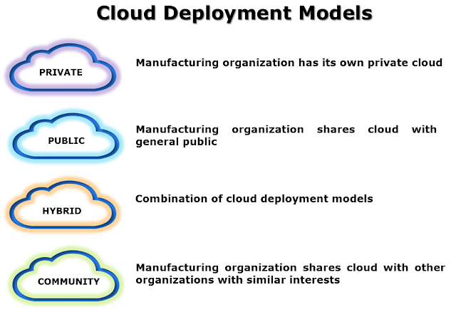
Deployment Cloud Models
HPE, DELL, ORACLE, |RedHat, etc
AWS-VPC, AZURE-AzureStack
AWS, Microsft Azure, Google Cloud Plat, Alibaba, etc

Slide 10
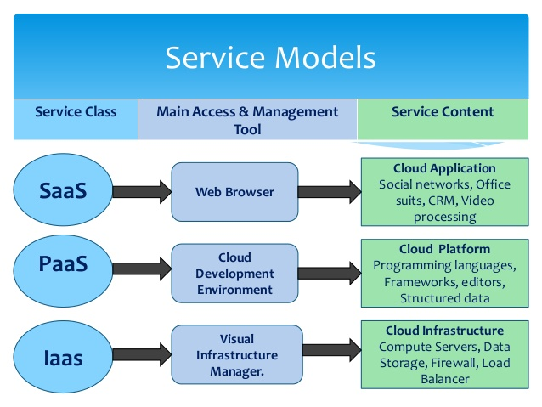

Slide 11
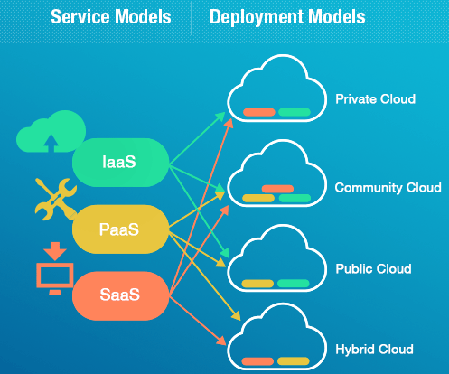

Slide 12
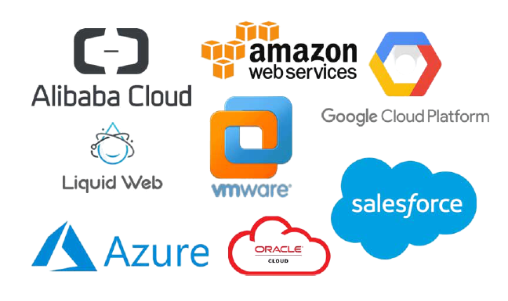
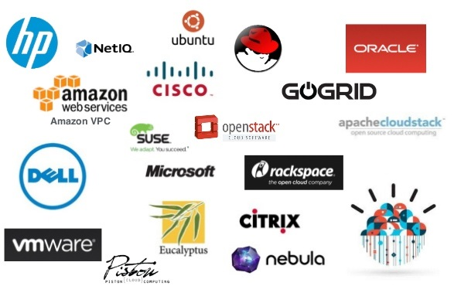
Top Cloud Service Providers
Public Cloud Providers→
←Private Cloud Providers

Slide 13
Why AWS
Cost Saving
Scalable & Adaptable
Security
Location, Location, Location
Automated Multi Region Backups
Streamlined Disaster Recovery
Consistency & Reliability
Simple Automated Scheduling
Pay-As-You-Go Pricing
Customization
Third Party APIs
& Lots of Services…………..

Slide 14
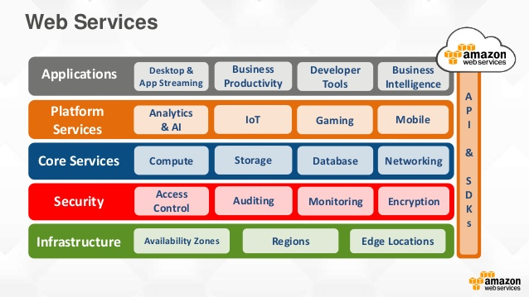

Slide 15
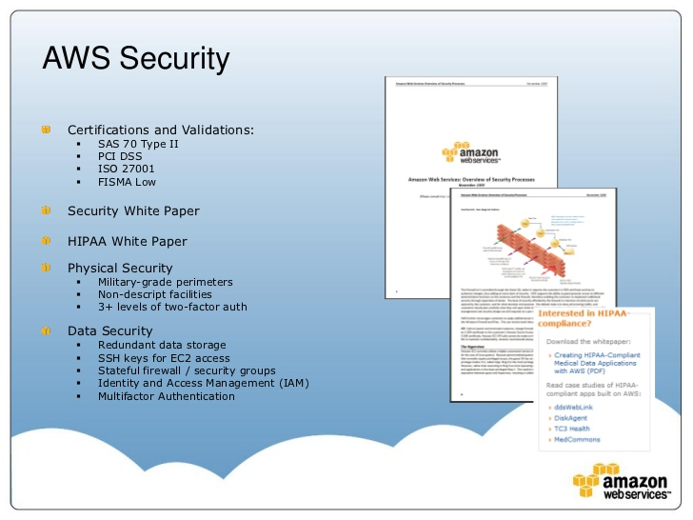

Slide 16
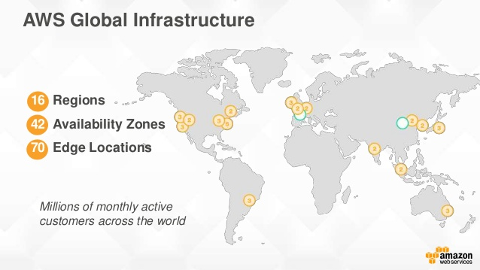

Slide 17
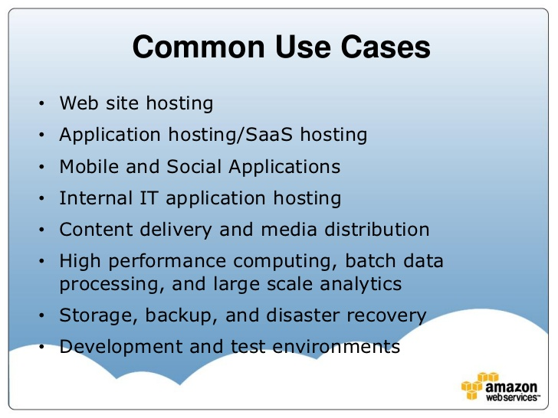

Slide 18
Enterprises Use Cases on AWS
Enterprise Apps and Dev./Test
Storage, Backup and Archival
Big Data
Web, Mobile, and Social Apps
Disaster Recovery
Virtual Desktops

Slide 19
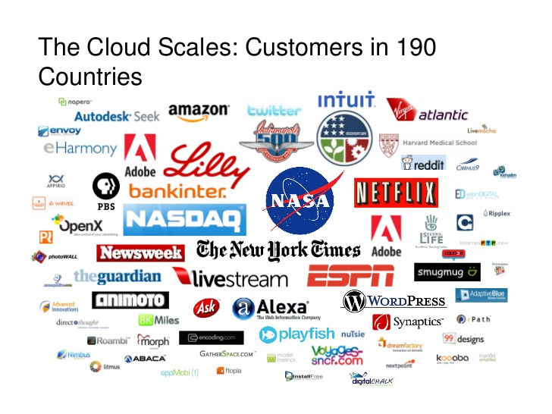

Slide 20
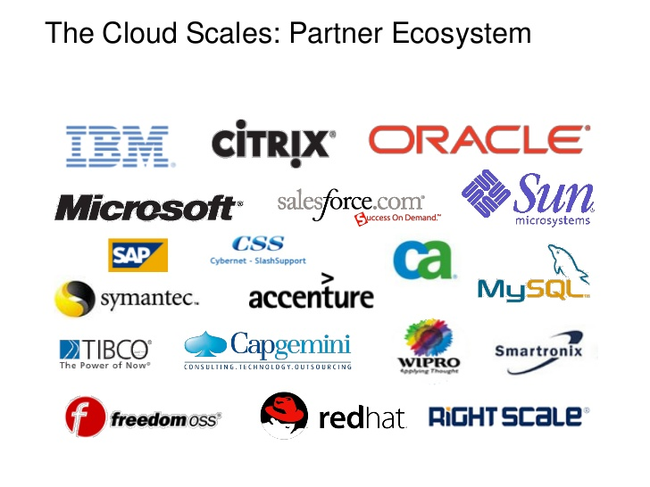

Slide 21
Advantages of AWS Cloud
Lower Computer Costs / IT Devices
Improved Performance
Reduced software costs
No worry about software updates or patch updates or any update
Unlimited Storage capacity
Increased data reliability
Universal access
Device independence

Slide 22
Disadvantages of AWS Cloud
Requires constant internet
Limitations of EC2 instances to region to region
Security Limitations on some features
No free Technical Support

Slide 23
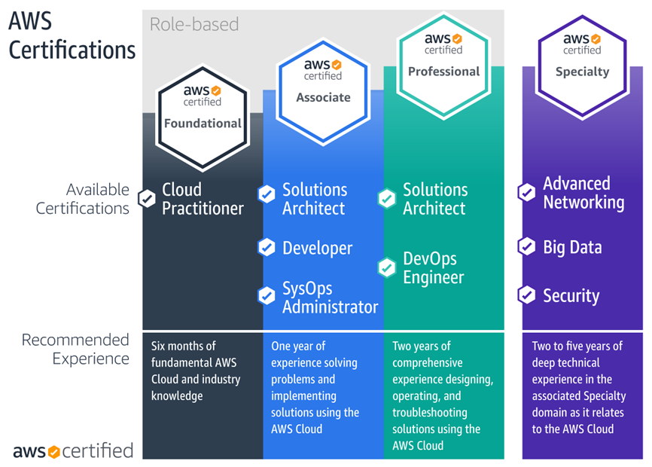

Slide 24
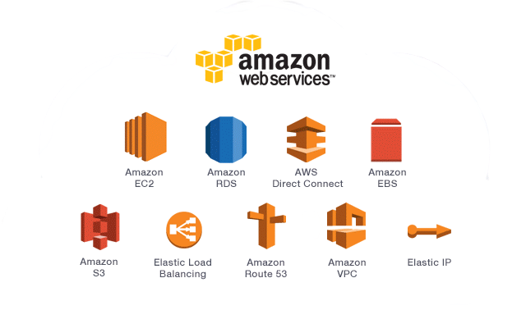
Topics Covered in AWS Solutions Architect Associate Course

Slide 25

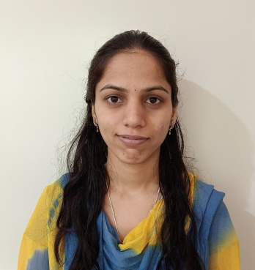
NetLeap Founder Members
Mrs. Mrunal Dahale
Director
(Forensic Consultant, Network, Windows Expert)
Miss. Priyanka Gaikwad
Director
(RedHat & Linux Technologies Expert)
Mr. Dinesh Chaudhari
Director
(Network & Cloud Expert)

Slide 26



NetLeap Faculty Members
Miss. Swarada Kabnurkar Advocate
(B.S.L.LL.B & Diploma in Cyber Law)
Mr. Aman Gupta
(Ethical Hacking & Forensic Expert)
Mr. Gaurav Shirsath
(Cloud Developer, Native & Object Oriented Language Expert)

Slide 27
Visit Us
www.netleap.co.in

Slide 28

NetLeap IT Training & Solutions
9307338125 / 8329349481 Address – Flat No 03, Sitagufa Society, Near Vidya Vikas Circle, Gangapur Road, Nashik.

